Slide 1
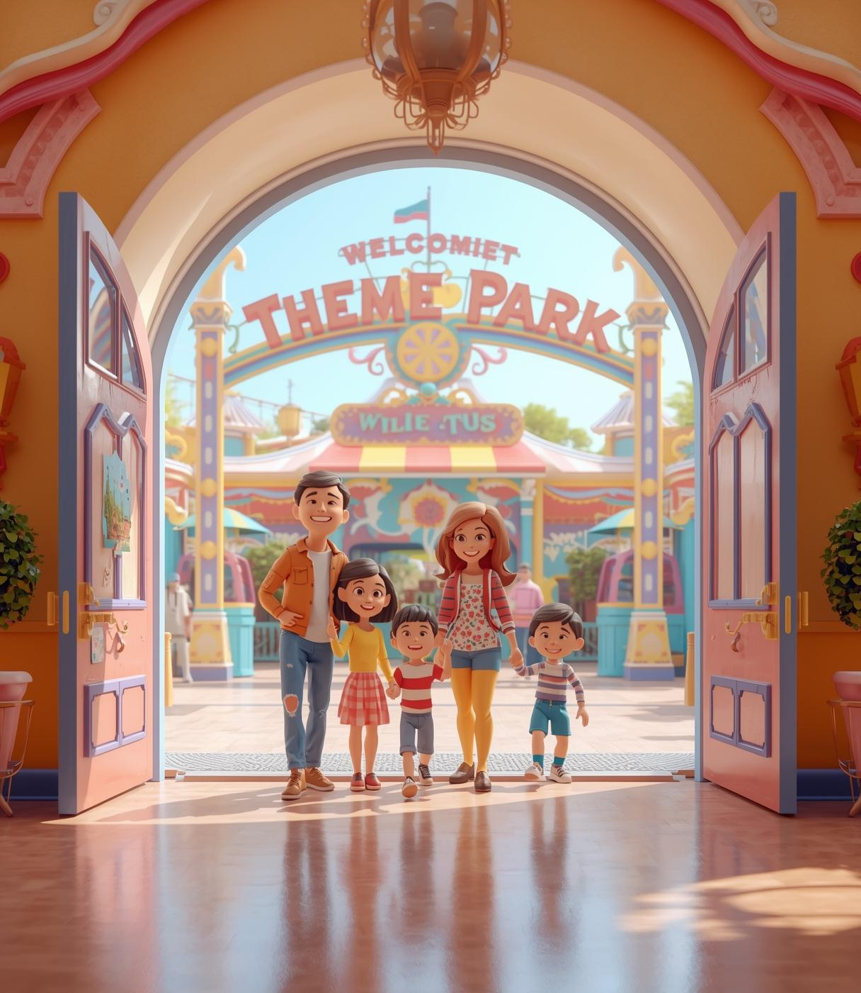
ThemeParkTicket Booking
Designed by Vishan Paul
Technologies Used : ReactJS, Spring Boot, MongoDB
Objective : To automate the theme park ticket booking and management process with an efficient full-stack web solution.

Slide 2
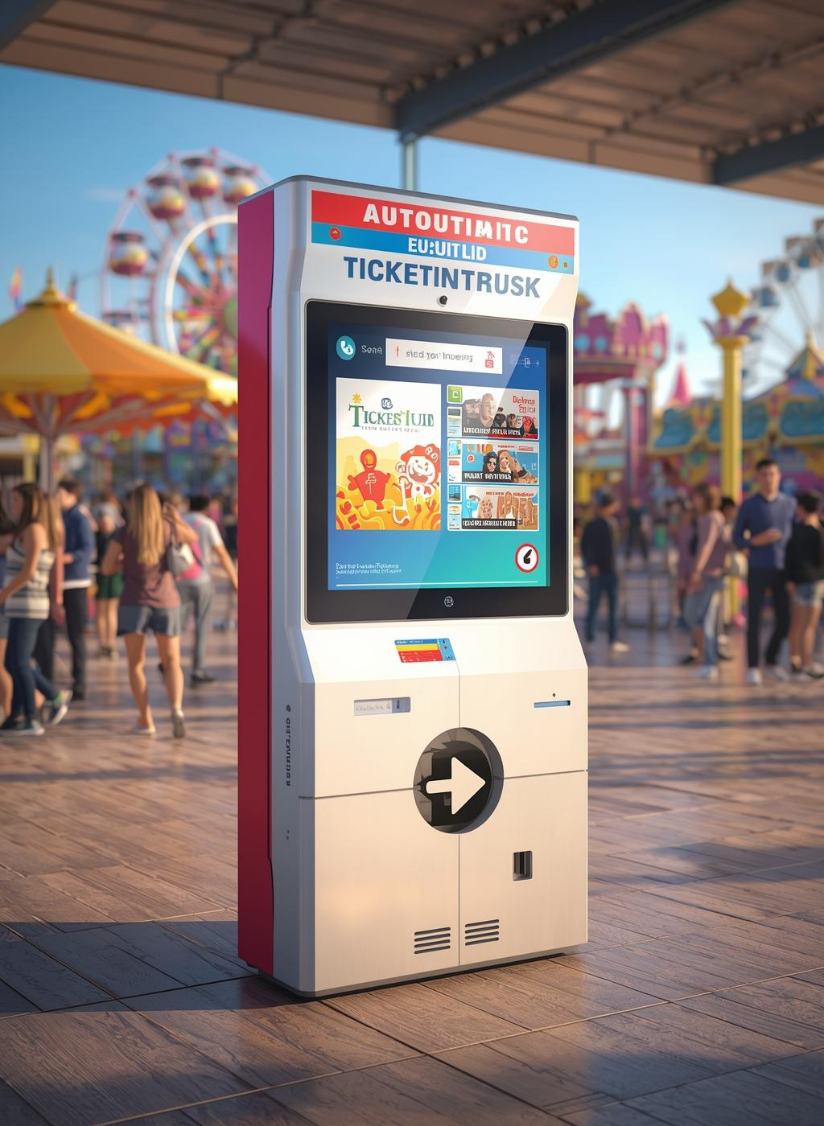
Abstract
The Theme Park Ticket Booking System is a full-stack web application that simplifies the ticket reservation process for users and administrators.
It allows visitors to book tickets online, check availability, and view booking history, while admins manage pricing and visitor data digitally.
Built using ReactJS (frontend), Spring Boot (backend), and MongoDB (database), the system ensures real-time updates, secure storage, and smooth communication between all layers.
This project focuses on improving speed, accuracy, and convenience for both customers and park management.

Slide 3
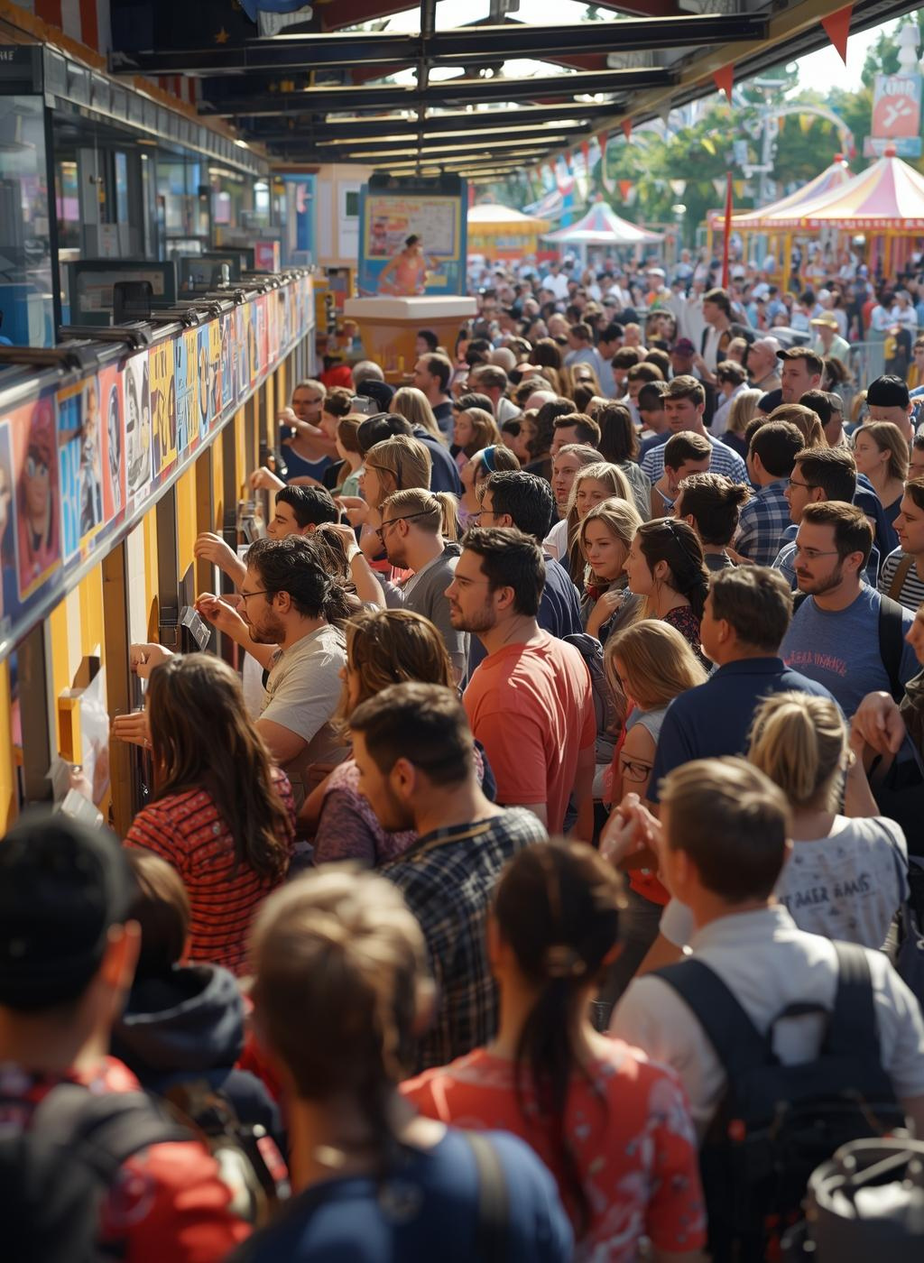
Existing System
Ticket booking is handled manually at counters, leading to long queues.
Human errors occur during data entry and billing.
No centralized data management or tracking of bookings.
Lack of real-time ticket updates or online accessibility.
Time-consuming and inefficient for both staff and customers.

Slide 4
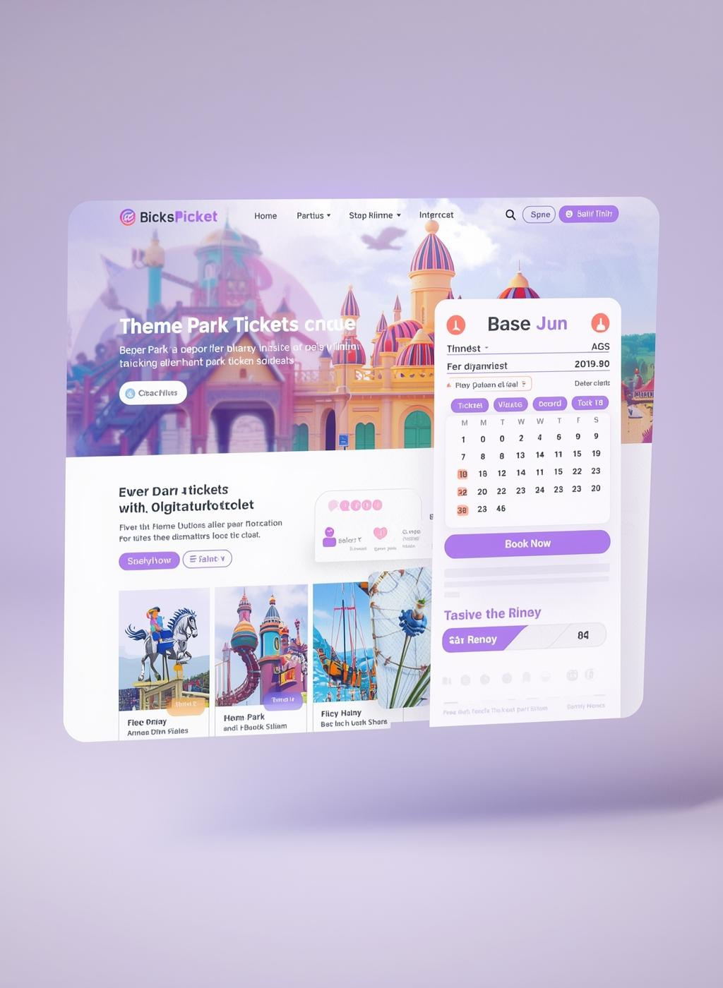
Proposed System
Introduces a fully digital ticket booking process.
Allows users to book tickets online and receive instant confirmation.
Admins can update ticket details, manage users, and monitor bookings.
Ensures real-time synchronization between frontend, backend, and database.
Provides a secure and user-friendly interface accessible from anywhere.

Slide 5
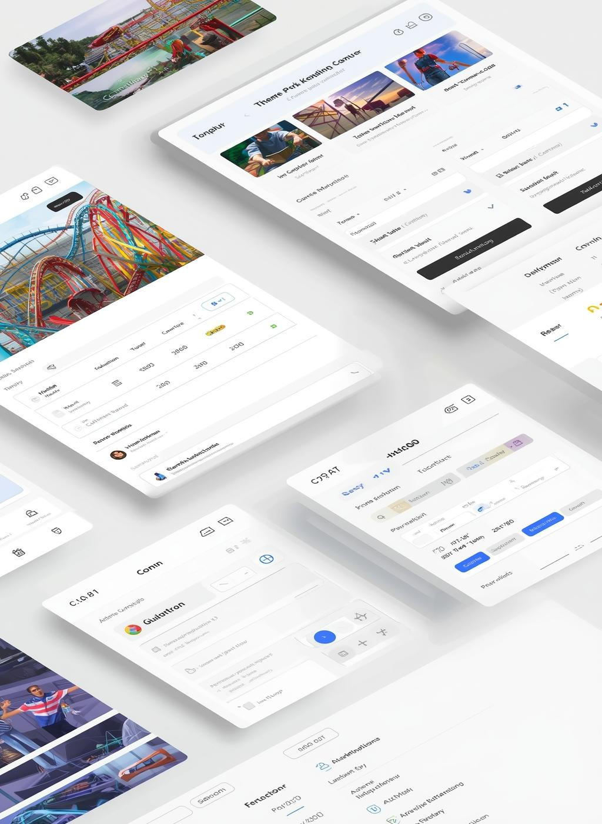
Advantages & Disadvantages
Advantages:
Fast, error-free, and paperless booking process.
Provides real-time ticket availability and transparency.
User-friendly UI and easy database management.
Saves time and reduces manual workload.
Disadvantages:
Requires internet connectivity.
Server downtime may affect booking process.
Initial setup requires technical configuration.

Slide 6
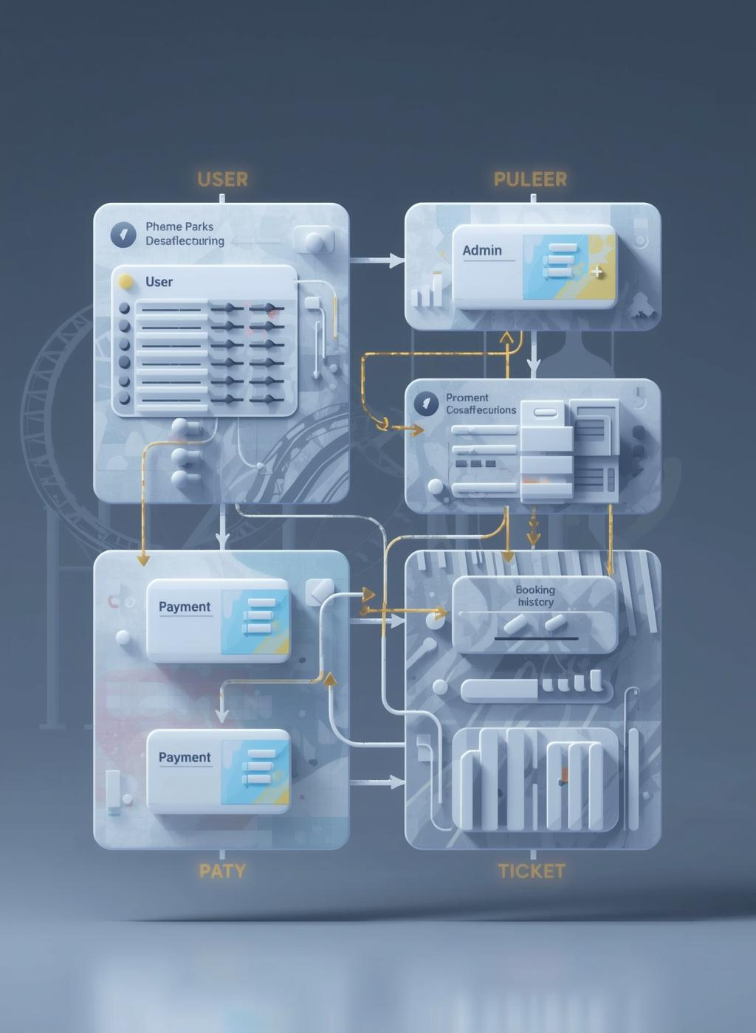
Software Requirements
Software Requirements:
Frontend: ReactJS
Backend: Spring Boot
Database: MongoDB
Tools: VS Code
Browser: Google Chrome / Microsoft Edge
Server: Spring Boot Embedded Tomcat Server

Slide 7
Hardware Requirements
Hardware Requirements:
Processor: Intel i3 or higher
RAM: 4 GB or more
Hard Disk: Minimum 500 GB
Monitor: 1024 × 768 resolution
Operating System: Windows 10 or above

Slide 8

Modules
User Module : Registration, login, and ticket booking.
Booking Module : Ticket selection, date management, and booking confirmation.
Admin Module : Manage ticket prices, view users, and booking data.
History Module : Display past bookings and payment details.
Report Module : Generate daily or monthly booking summaries.

Slide 9

Module Description
User Module: Handles login/signup and allows customers to book tickets.
Booking Module: Ensures booking validation, payment confirmation, and generates booking IDs.
Admin Module: Controls pricing, user access, and viewing of reports.
History Module: Stores past bookings for user reference.
Report Module: Provides statistical data to admin for decision-making.

Slide 10
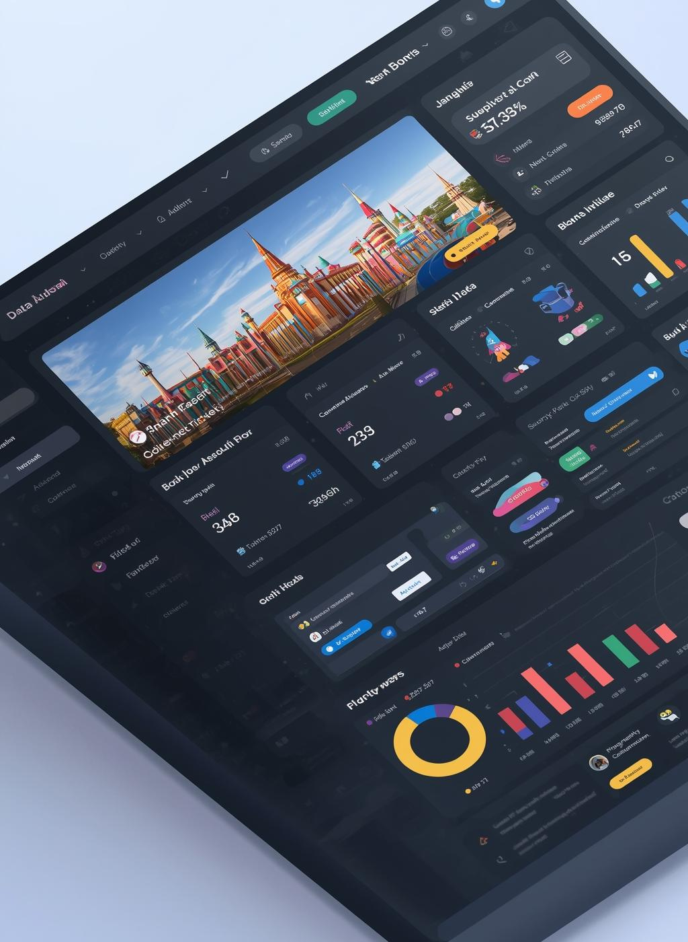
System Architecture
Flow:
User → React Frontend → Spring Boot Backend → MongoDB
Database
React JS: Handles user interface and client-side logic.
Spring Boot: Processes requests and connects to the database.
MongoDB: Stores user details, bookings, and admin data.
REST API: Connects frontend and backend for smooth communication.

Slide 11
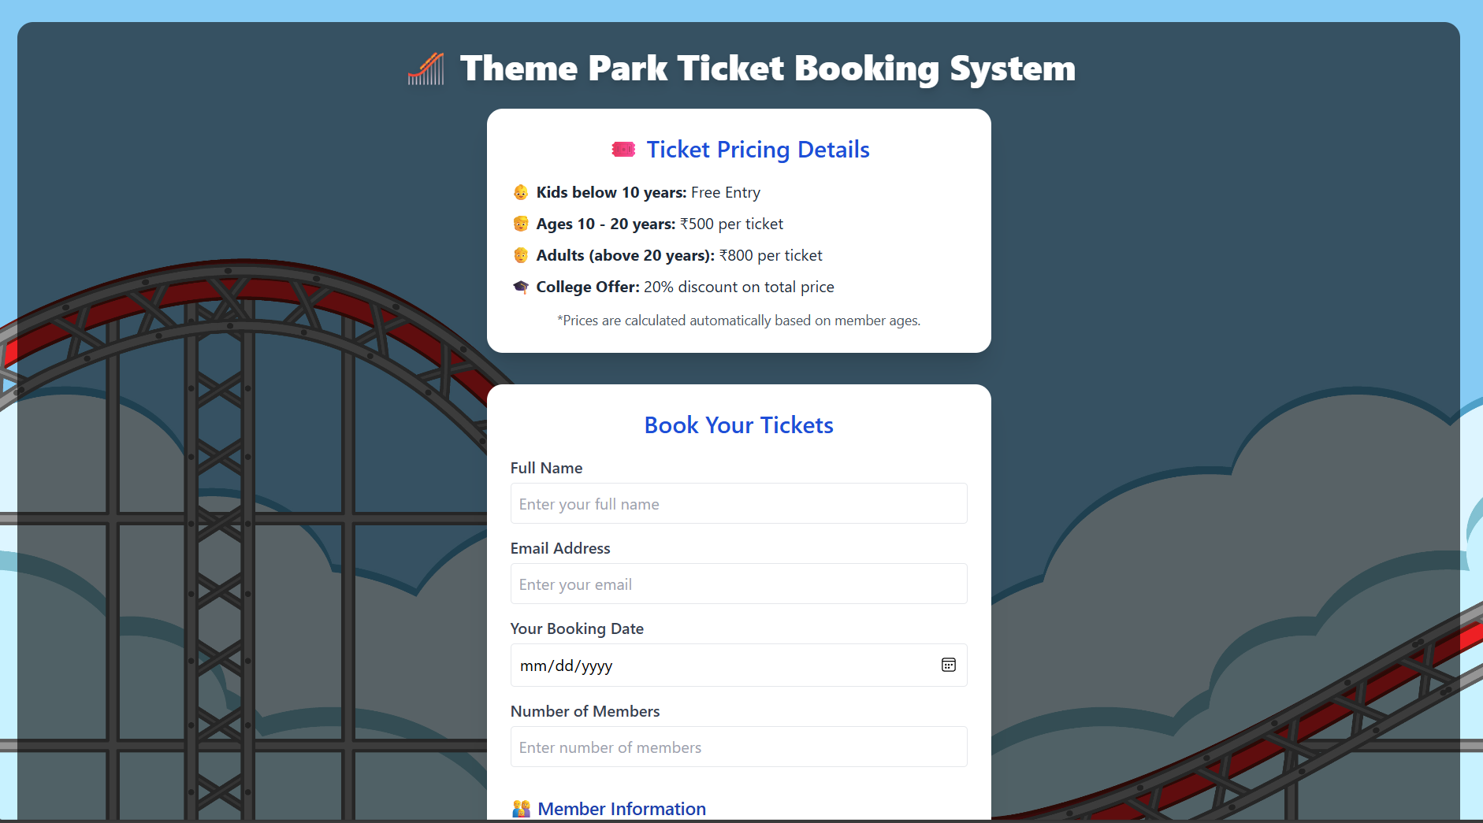
Sample Output

Slide 12
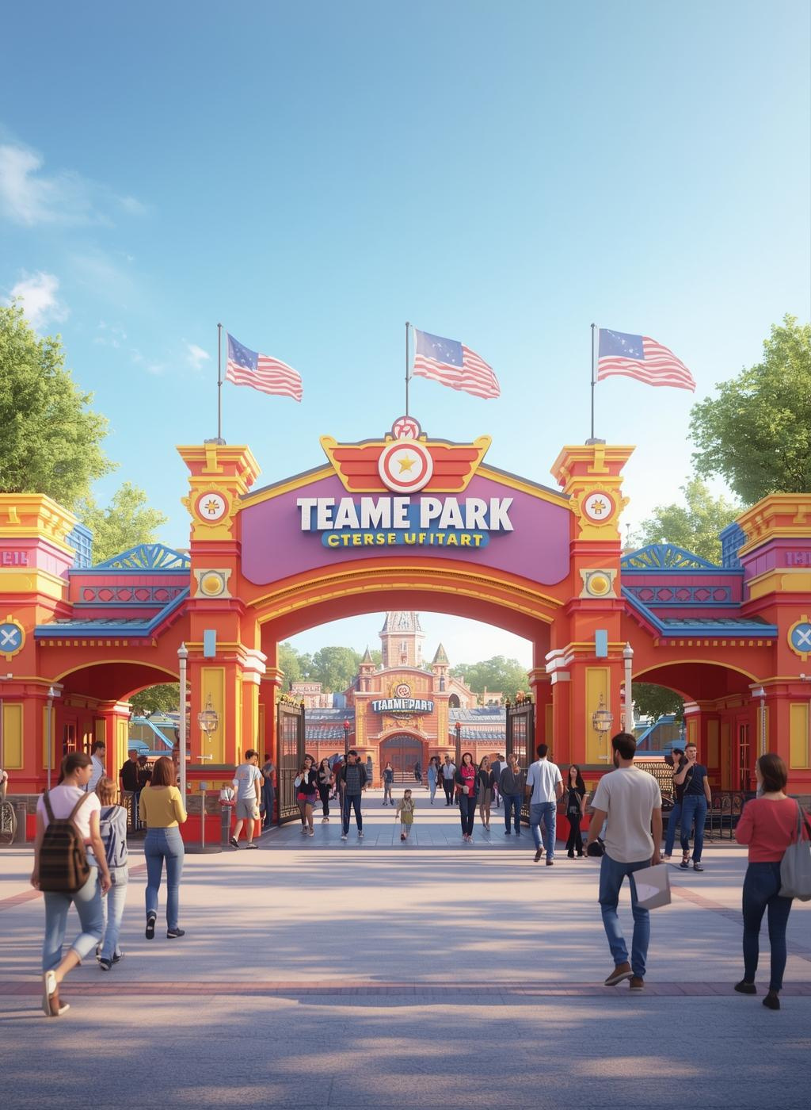
Conclusion
The Theme Park Ticket Booking System successfully automates the manual process of park ticketing.
It provides a secure, efficient, and reliable platform for both users and administrators.
By integrating ReactJS, Spring Boot, and MongoDB, the system achieves real-time data processing, better performance, and modern web scalability.
This project demonstrates the potential of full-stack web development in simplifying real-world tasks.

